Slide 2
Write your own definition here
vaping
Exercise
Insert examples of good and bad habits under the categories with pics, gifs, and text boxes

Slide 3
What happens to a bottle of soda when you shake it up?

Slide 4
Sometimes things go wrong, and we feel shaken up. As a result, we might EXPLODE on someone or something. This is called being REACTIVE. Has this ever happened to you? Explain what happened and why.
Was this a good way to let go of all of your feelings? Why or why not?
Write your answer here
Write your answer here

Slide 5
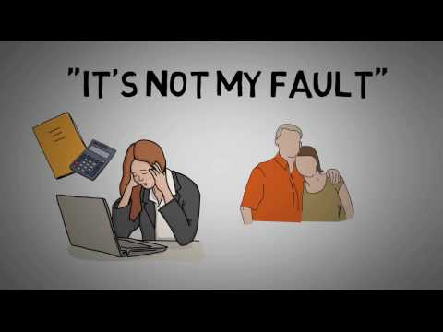

Slide 6
Proactive vs. Reactive
When you are PROACTIVE, you make good choices about how you respond to something happening. You are always ready with a calm attitude. You do things to make sure that the right things will happen. You are prepared for anything that might happen. When things don’t go your way, you aren’t happy, BUT you stay calm.
When you are REACTIVE, you could explode at any minute. Things happen and they “catch you off guard”. You aren’t ready for things that might happen. You deal with things when they happen instead of being prepared.

Slide 7
Instructions: drag and drop the words where you feel they best fit on the proactive or reactive side of the rope
Reflection: highlight the words you feel best reflect you and your actions.
Are you more proactive or reactive in life?
Are you happy with where you are at?
Takes responsibility for their lives
Makes choices based
off values
Thinks before acting
Calm and cool
Full of pressure
What would you change?
Answer here
Places blame on others
Doesn’t think before speaking
Makes choices based
off impulse

Slide 8
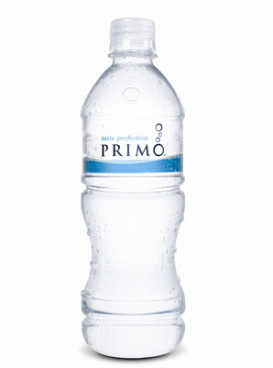
When you are PROACTIVE, you make a choice about how you react to the things that happen in your life. You act like a water bottle. You might get shaken up or mad, but you stay calm and don’t explode!

Slide 9
Is it hard to stay calm (like a water bottle) even when things don’t go your way?
Why or why not?
What steps could you take to be more PROACTIVE and calm when things aren’t going well?
Yes no
Move the circle to your answer
Write your answer here
Write your answer here

Slide 10
/Influence
Instructions: Drag and drop the words into the circles where they fit. The white circle are things that are outside of your control, the gold circle, is what you CAN control
Your attitude
The weather
Write your own
Things you did wrong in the past
Your mood
Write your own
Your reaction to good and bad
How other people treat me
Write your own
Homework
Write your own
How I treat other people
Other people

Slide 11
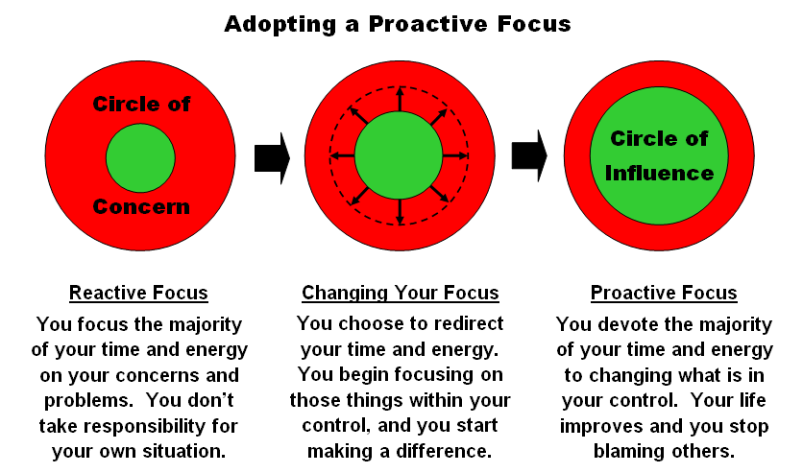

Slide 12
Be Proactive
Change how you handle things. Make a choice to be positive and focus on those things that YOU can change.
Make a positive difference in your family, your class, your school and the world!

Slide 13
Choices
Read the following scenarios and decide if the decision was proactive or reactive. If Reactive, what should they do instead? Drag a gold star sticker to Proactive choices.
Ms. Raven’s internet goes out but she knows she has to teach class. So she logs into google meets from her phone and teaches, until she can get to the library or a coffee shop to use their internet.
Susie Q failed her science test and Dr. B said she would be calling home. Susie is afraid of what her parents will say so she takes her mom’s phone and deletes Dr. B’s message.
Sally Sunshine went on vacation with her family and forgot her ipad at home. She used her phone to email her teachers and check her schoology and after her families activities, she writes her assignments on paper and submits a photo and wakes up early to use the Hotel’s business center where there are free computers to use. When she is able, she even joins google meets from her phone.
Super Mario slept through class and now doesn’t understand the assignment. Mario screams in his pillow and says, “It’s not my fault my mom didn’t wake me up!” and goes back to sleep. Mario gets a Zero on the assignment.

Slide 14
How can we be proactive with our conferences tomorrow?
Go over the conference slides with our parents ahead of time
Show our parents our grades and comments the teachers have made
Show our parents our plan and come up with a plan together to get our missing work and revisions turned in

Slide 15
What is your plan for being proactive with your conferences for tomorrow? Finish the sentence starters
I will….
I hope…
I wonder…
I worry about…..

Slide 18
In order for something to be a goal…..
It has to be important to you, personally
Has to be within your power and actions to make it happen
Must have reasonable chance of achieving
Must be clear to you and have specific plan of action.

Slide 20
SPECIFIC
What, Why, How
What are you going to do?
Why – is this important to do at this time? What do you want to accomplish?
How are you going to do it? (By doing….)
Poor Example: I will
exercise more.
Good Example: I will walk for 30 minutes every day.

Slide 21
MEASURABLE
Ask Yourself:
How much do I have to do?
How many times do I have to do it?
(How much, How many?)
If you can’t measure it, you can’t manage it.
You have to be able to see the change occur.

Slide 22
ATTAINABLE (within your reach)
Setting yourself up for success!
A goal needs to make you slightly uncomfortable, so that you know it needs a real commitment from you.
Facing and overcoming challenges will motivate you to move on to bigger challenges and more satisfying accomplishments.

Slide 23
REALISTIC (Do-able, Not Easy or Ridiculous)
Poor Example: I will not watch television
Realistic Example: I will not watch television until my homework is done.

Slide 24
TIMELY
Set a timeline
Must have a set deadline:
When do I want to have the goal accomplished?
What steps to achieve my goal and keep me on track?

Slide 25
Personal
A personal goal is something that you want to do to make your life better. Examples include: Reaching a fitness or health goal, a family goal, or a
money goal.
Short term:
A short term goal is something that can be achieved quickly- think maybe a week, month, or quarter of school
Social
A social goal increases your interpersonal skills. It might be something like joining a club or sport, starting a club, or being nicer to people and making new friends, sticking up for yourself, setting boundaries, etc.
Long term
A long term goal is usually something that is longer than a couple of years. It could be at the end of your 5 year plan or even longer
Academic
An academic goal helps you be a better student. These can be around grades, getting a certain honor cord at graduation, a scholarship, or reaching a certain GPA
There are also midterm and immediate goals.

Slide 26
Let’s Practice together
In the chat, everyone write one goal you have…
Let’s choose one to do together as a class
Is this goal SMART?
What are we already doing to reach this goal?
What do we still need to do in order to be successful to reach this goal?
What can help us stay on track?
What sort of reward can we get for reaching this goal?

Slide 27
Instructions: DO NOW IN CLASS (we will do one example to get started together) create text boxes to fill out each section of the goal chart. Make sure your goals are SMART
(Goals I can meet this quarter)

Slide 28
Instructions: create text boxes to fill out each section of the goal chart. Make sure your goals are SMART
(Goals I can meet this year)

Slide 29
Instructions: create text boxes to fill out each section of the goal chart. Make sure your goals are SMART
(Goals I can meet in 4 years)

